Slide 1
UIT2201 – Programming and Data Structures
Lecture-04
Objects and Classes

Slide 2
Object Oriented Programming
Python supports object-oriented programming that enables abstraction of data and encapsulation of data along with operations on the data
An object is an abstraction of data that hides the representation of data and the underlying memory model
Messages can be passed to an object, and that object executes the corresponding method (function)
Objects of same type are grouped together as a class
A class provides both abstraction and encapsulation: It defines the fields of an object; and also defines the methods

Slide 3
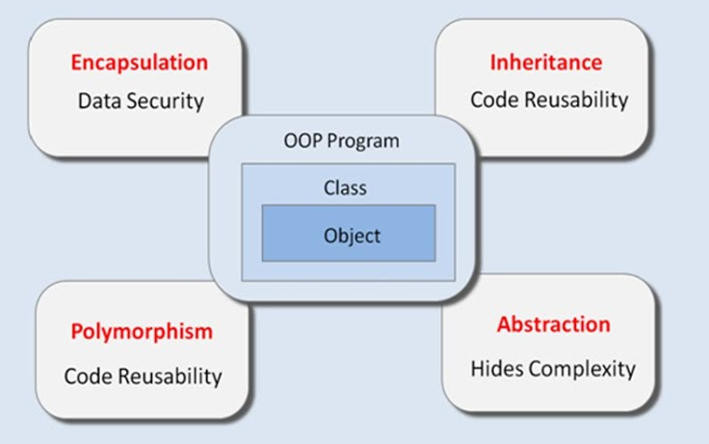
Advantages of Object Oriented Programming

Slide 4
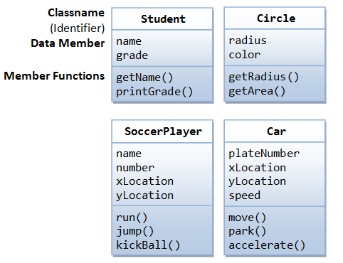
Examples of class

Slide 5
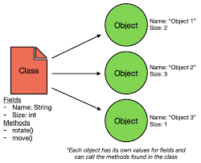
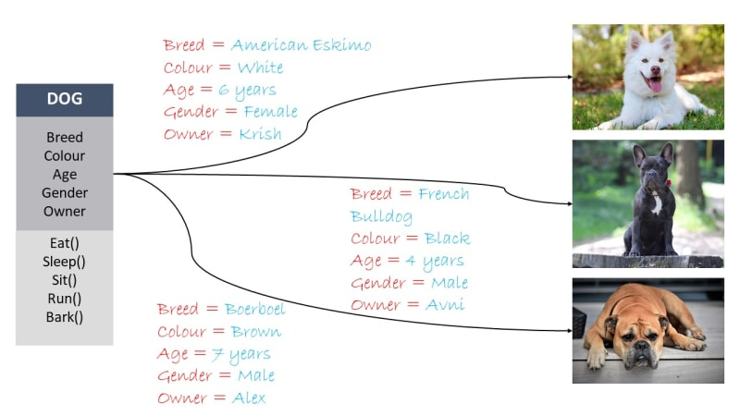
Objects or instances

Slide 6
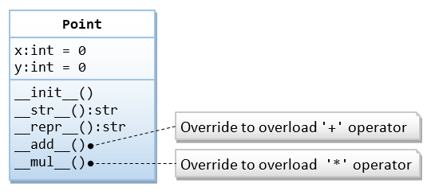
2D Point example

Slide 7
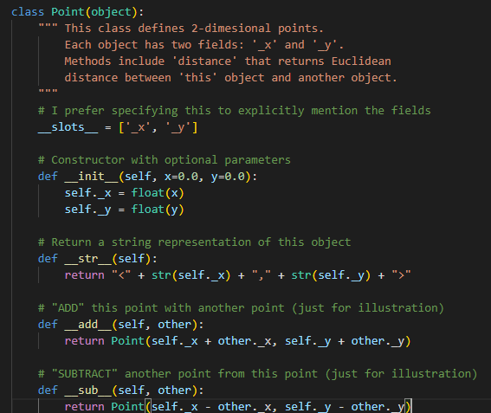
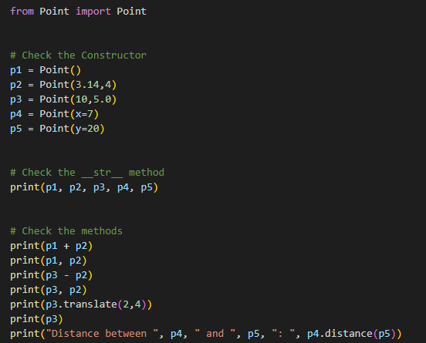
Point Class Example
Point.py
PointTest.py

Slide 8
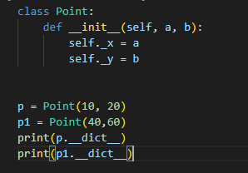

Usage of dictionaries to manage instance attributes
Python uses the dictionaries to manage the instance attributes.
The dictionary allows you to add more attributes to the instance dynamically at runtime.
For every instance object, we will have an instance of a dictionary that consumes more space and wastes a lot of RAM.
Output

Slide 9
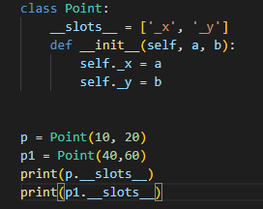

Need for__slots__
Usage of __slots__ reduce the wastage of space and speed up the program by allocating space for a fixed amount of attributes.
To avoid the memory overhead, Python introduced the slots. If a class only contains fixed (or predetermined) instance attributes, you can use the slots to instruct Python to use a more compact data structure instead of dictionaries.
Output

Slide 10
Operator Overloading
Python’s built-in classes provide natural semantics for many operators.
For example, the syntax a+b invokes addition for numeric types, yet concatenation for sequence types.
When defining a new class, we must consider whether a syntax like a+b should be defined when a or b is an instance of that class
By default, the + operator is undefined for a new class. However, the author of a class may provide a definition using a technique known as operator overloading
This is done by implementing a specially named method.

Slide 11
Python’s Special Methods
In particular, the + operator is overloaded by implementing a method named __add__
That is, the syntax, a+b, is converted to a method call on object a of the form, a. __add__ (b)

Slide 12
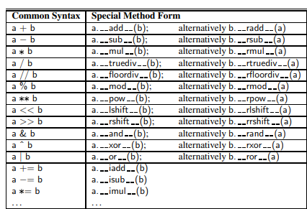
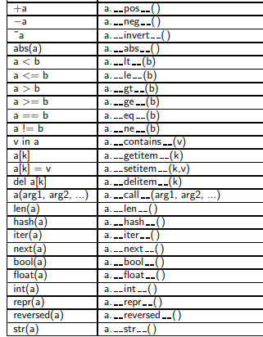
Comprehensive list of Python’s Special Methods

Slide 13
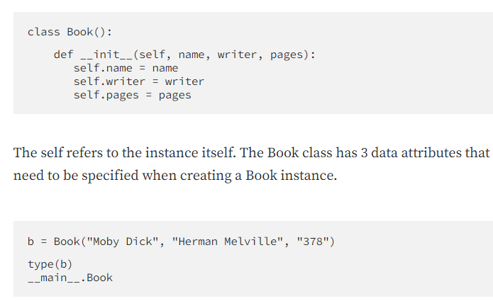
Special Methods for Python __init__
The __init__ special method is automatically executed when an instance of class is created. It is also called class constructor. The parameters of the __init__ represent the data attributes of a class.

Slide 14
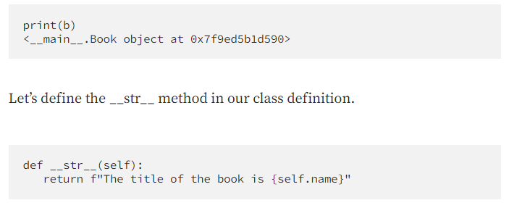
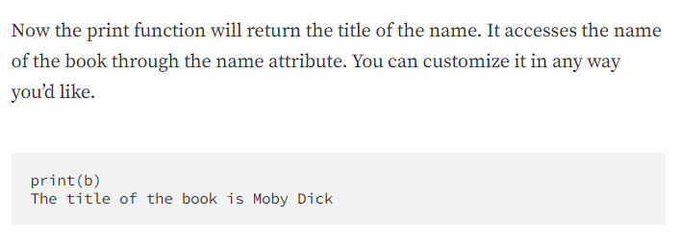
Special Methods for Python __str__
We use the __str__ special method to implement the built-in print function within our class. Without the __str__, here is what print function does.

Slide 15
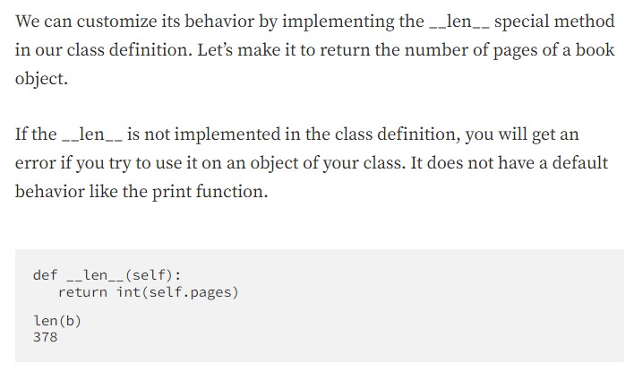
Special Methods for Python __len__
The len function returns the length of an object. For strings, it returns the number of characters.

Slide 16
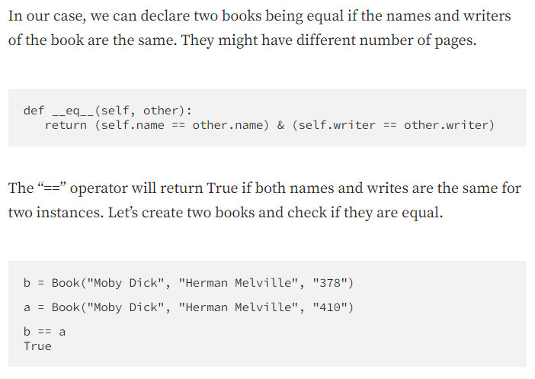
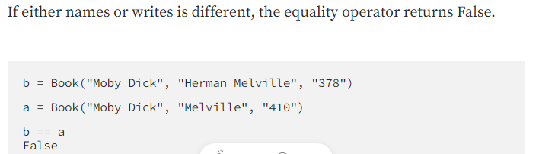
Special Methods for Python __eq__
The __eq__ special method allows for comparing two instances of a class.

Slide 17
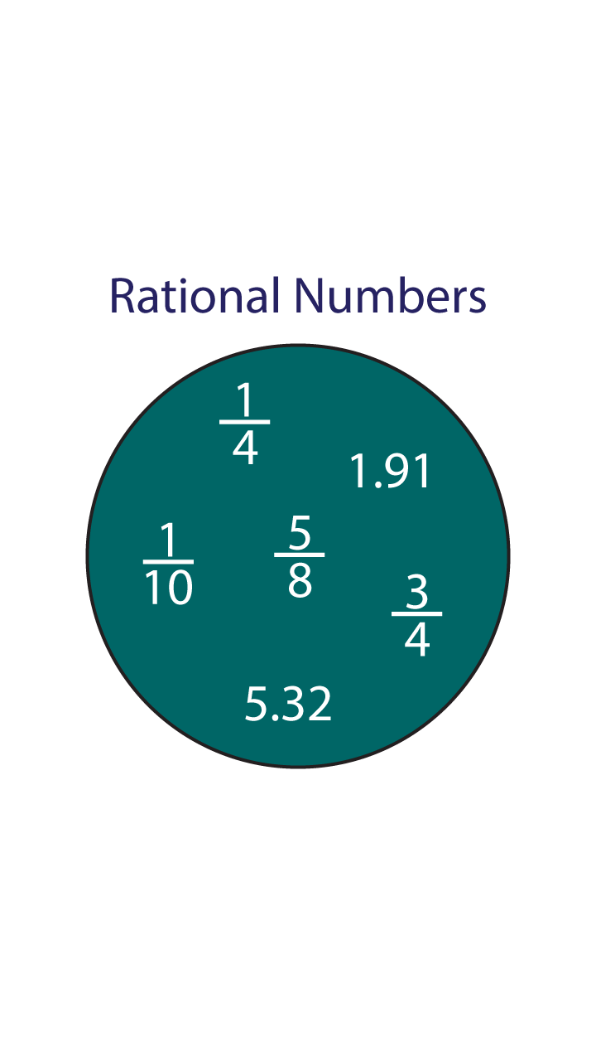
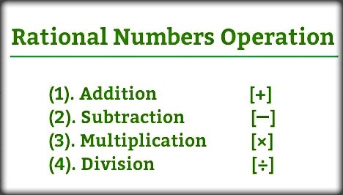
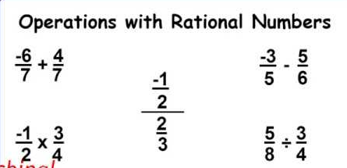
Rational Number example

Slide 18
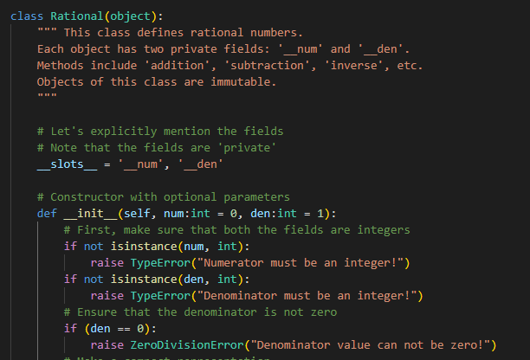
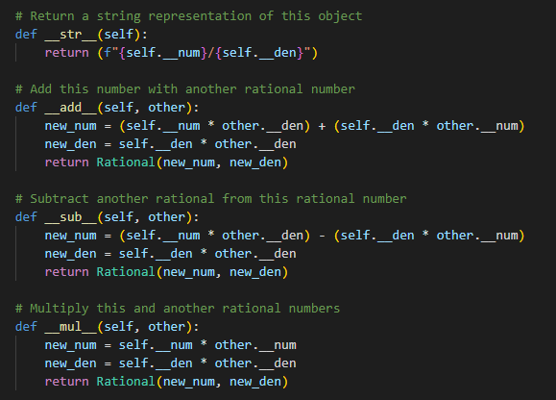
Rational number class Example
Rational.py

Slide 19
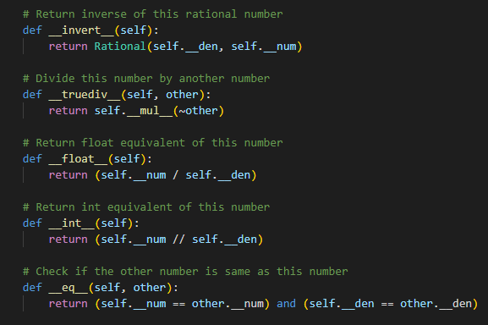
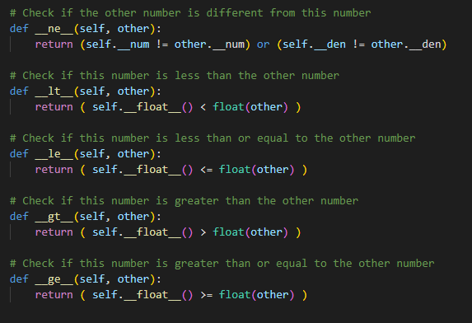
Rational number class Example (contd…)
Rational.py

Slide 20
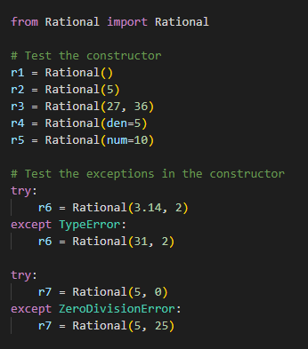
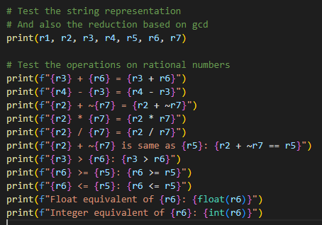
Rational number class Example (contd…)
RationalTest.py

